Slide 1
UNIT TWO
ORGANIZATION OF COMPUTER SYSTEM

Slide 2
3.1 Introduction to Computer System
A System is any collection of related component or elements (also called subsystems) that work together to achieve some objective (s).
The components collectively make the whole (the System). Each component has a specific task to accomplish.
A Computer is not a single machine. It is a system and the system contains lot of subcomponents.
A Computer System is made up of both hardware and software.
Hardware refers to the physical components of a computer system that is carried out capturing, processing, providing output, storing data and transmission of data.
Software is another term for computer program i.e. is a series of instructions that tells a computer what to do and how to do it.
1. Computer Hardware
The hardware of a computer system is made up of a number of electronic devices connected together.

Slide 3
It is composed of a number of interacting physical parts based on the need of the information.
Generally, the basic elements of the computer hardware are categorized in to five sections.
Input Devices
Output Devices
System Unit (Central Processing Unit, Expansion Slots, Memory, ports, hard drives and etc.)
Secondary Storage Devices
A communication network called Bus/Cables, which links all the elements of the system and connects the system to the external devices.
Input Devices
An Input Device is any hardware device component that allows/enables users to enter data or programs into a computer.
This device converts data or instructions from a form suitable to human beings to one understandable by the computer.

Slide 4
The most commonly used Input Devices are categorized as Keyboard, pointing device (example: Mouse), reading tools like Scanner and Digital Camera.
Keyboard
A Keyboard is an Input Device that contains keys users press to enter data into a computer.
Desktop computer keyboards normally consist from 101 to 105 keys.
These keys can be divided into five sections.
Typing keys:
These keys include English Alphabets A – Z, digits 0 -9, Enter Key, Space, Backspace Key, Caps Lock Key etc.
The general use of typing keys is to enter characters.
ii. Computer keys
Keys like ‘Ctrl’, ‘Alt’, ‘Shift Keys’ etc.
They are used usually in conjunction with other keys.
iii. Function keys
Keys labeled F1, F2, F3… F12 are Functional Keys.

Slide 5

These Keys perform different tasks based on the type of software/program being used.
v. Numeric keys
These keys let you enter numerical data more easily when you are working on number intensive tasks.
The numeric key contains mainly the numeric digits keys (0 – 9), the four mathematical operators (+,-,*, /) etc.
To use this section, the keyboard makes sure that the Num Lock key in your Keyboard is on.
vi. Navigation keys / Cursor movement keys
These are keys that are used to navigate through your document.
They are used to move pointers and/ or cursors around the monitor screen.
The following are Navigation Keys:
Page up, Page down, Home, End and etc
The following keys are very important:

Slide 6
The Shift keys are used to type capital characters when you are working with small letters and special characters labeled on the keys such as ?, !, @, &, #, $, *, etc.
The Print Screen key is used to print a paper copy of whatever is on the screen when the key is pressed (if a printer is attached).
The Pause key temporarily suspends an activity, pressing the pause key once stops the activity, pressing any typing key (except shift, caps lock) resumes the activity.
B. Pointing Devices
A Pointing device is an input device that allows a user to control a pointer on the screen.
Mouse
Mouse is used to move the cursor on your computer screen, to give instructions to your computer and to run programs and applications.
It can be used to select menu commands, move icons, size windows, start programs, close windows etc.

Slide 7
b. Touch screen
It allows the user to operate a computer by simply touching the display screen.
Example of a Touch Screen:
Phones,
Laptops,
Tablets and ,
ATM at a bank.
The most common screens we interact with today are capacitive and resistive touch screens
1. Capacitive Touch Screens
Capacitive screens are made up of multiple layers of glass and plastic, coated with a conductor material like indium tin oxide or copper.
This conductive material responds when contacted by another electrical conductor, like your bare finger.

Slide 8
When you touch your screen:
An electric circuit is completed at the point where your finger makes contact, changing the electrical charge at this location.
The device registers this information as a “touch event.”
Once a touch event has been registered, the screen’s receptors signal this event to the operating system, prompting a response from your device.
Capacitive touch screens generally have a brighter, clearer appearance and are much more sensitive than resistive touch screens.
We tend to see capacitive touch screens in more modern technologies like smartphones, laptops and tablets.
They give us the ability to experience high-quality imagery that imitates reality

Slide 9
2. Resistive Touch Screens
Resistive touch screens work exactly how their name implies - with resistance to touch.
A glass or hard plastic layer is blanketed by a resistive metallic layer that conducts charge.
The two are separated by spacers in the screen so that when your finger presses firmly on the plastic protective layer, the two layers make contact changing the electric charge at that location, which cues the software to respond.
Resistive screens are not as bright as capacitive because of their thick blue and yellow colored layers that make their interface appear darker than capacitive screens.
You’ll often see resistive screens used on ATM machines, checkout stands, and POS (point of sale) terminals.
They tend to be much more durable and affordable than capacitive screens, thanks to that hard plastic outer layer.

Slide 10
Each screen has strengths and weaknesses that make it a better choice for certain applications.
Capacitive screens offer more flexibility in functionality as resistive screens lack the ability to register multiple touch points at the same time
Think about when you zoom in on your smartphone - you’re using two fingers at different receptors to zoom in on an image.
Resistive touch screens get confused when you try to apply multiple points to them, since their technology relies on recognizing pressure at a specific location.
What touch screens detect?
What touch displays detect differs depending on if the screen is capacitive or resistive.
Resistive screens rely on applied pressure which means that sometimes the tip of a pen or another object can initiate a response from the system.
Capacitive touch screens use electrical conductors rather than pressure to recognize a command and respond to the system.

Slide 11

c. Light Pen
Light pen is a pointing device similar to a pen. It is used to select a displayed menu item or draw pictures on the monitor screen. It consists of a photocell and an optical system placed in a small tube.
When the tip of a light pen is moved over the monitor screen and the pen button is pressed, its photocell sensing element detects the screen location and sends the corresponding signal to the CPU.
For most operating systems light pens are used as pointing devices with the same basic functional characteristics (to the operating system) as a mouse.
Special device driver software supplied by the light pen manufacturer provides the light pen with these characteristics.
The light pen is typically provided with a button, or buttons, that allow the user to execute a number of options in a manner similar to the buttons on a mouse

Slide 12
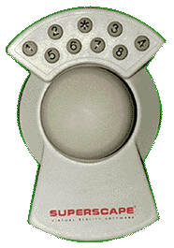
d. Track ball
Similar to a Mouse that has a ball.
A Track Ball is a pointing device with a ball on its top. It looks like an upside-down mouse.
To move the pointer you simply rotate the ball with your thumb, fingers, or the palm of your hand.
Tracker Balls have an advantage over the mouse that a flat surface is not required for its operation and does not require much space because the device is stationary

Slide 13
B. Reading Tools
These are input devices that save users time by eliminating manual data entry.
With these devices, users do not type or speak into the computer.
Instead, these devices capture data from a source document, which is the original form of the data.
Because of these reasons they are always called source data input devices.
The following are some of these devices:
1. Bar Code Reader
Bar Code Reader is a device used for reading bar coded data (data in the form of light and dark lines).
Bar coded data is generally used in labelling goods, numbering the books, etc.
It may be a handheld scanner or may be embedded in a stationary scanner.

Slide 14
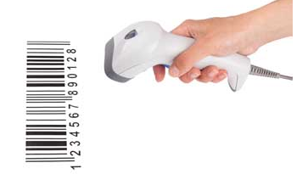
Bar Code Reader scans a bar code image, converts it into an alphanumeric value, which is then fed to the computer that the bar code reader is connected to the computer.
2. Image Scanner
Scanner is an input device that reads or scans printed text, image, and pictures or graphics and then produce a digital version of the image so that it can be fed in to the computer.
Scanner is similar to a photocopier, except that instead of producing a paper copy of the document you place on it, you get an electronic copy which appears on your computer screen.

Slide 15
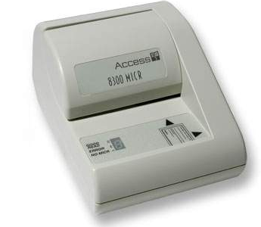
3. Magnetic Ink Character Recognition (MICR)
A special purpose machine known as reader or sorter reads these numbers and provides input that allows banks to efficiently maintain customer account balances.
MICR input device is generally used in banks as there are large number of cheques to be processed every day.
The bank's code number and cheque number are printed on the cheques with a special type of ink that contains particles of magnetic material that are machine readable.
This reading process is called Magnetic Ink Character Recognition (MICR).
The main advantages of MICR is that it is fast and less error prone.

Slide 16
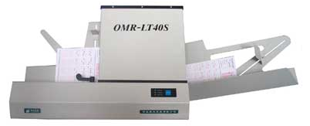
4. Optical Mark Recognition (OMR)
They read (determine location) of any pencil marks on specially designed papers for this purpose.
It is specially used for checking the answer sheets of examinations having multiple choice questions.
5. Optical Character Recognition (OCR)
OCR devices are very special because they do something more than scanning and that is they will scan (read) pre-printed characters and convert the data to a digital form and like the text editable with a word processor program.
OCR works like this:
Text will be scanned

Slide 17
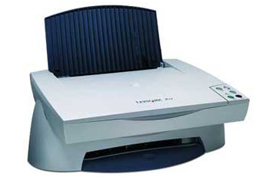
The page will be analyzed and here paragraphs and different formats will be identified
Each character will be checked with the set of characters already existing with the Software to find a match.
Whenever the match is found, the scanned character will be replaced by the match, but if the case is the opposite, then the software will take some measure like:
Replacing the character with no match by some special character.
Asking the user to enter by typing the unrecognized character.
Giving some suggestions and let the user to select the real character.

Slide 18
D. Video Input Devices
Generally speaking these kinds of devices will change video data into digital data and eventually manipulated by the computer.
There are always video cards involved
Digital Camera
Instead of film, a digital camera uses a light sensitive screen at the back of the camera.
A small computer inside the camera converts the pattern on the screen into a standard graphics file which can then be transferred to a computer.
E. Audio Input Devices
These devices help the user to enter sound data in to the computer systems.
Microphone
A microphone translates speech into an electronic signal.
Modern speech recognition software is able to translate this into either commands or data.
This enables the user to use a microphone as an alternative to the keyboard.

Slide 19
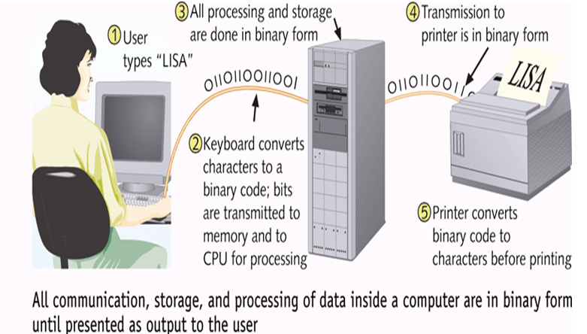
Fig: The diagram below shows how the various components of computer work together.

Slide 20
2. Outputs Devices
Output devices are used to get data either in the form of softcopy or hardcopy.
It is used to convert information from machine-understandable form to a human understandable form.
Softcopy:-displayed on monitor, projector or similar devices.
Hardcopy:-printed on paper.
Monitor
It displays visual information to the user, and is therefore an output peripheral device.
Computer Monitors are the display devices used to view the display output of a computer.
There are three types of monitories namely, CRT, LCD and LED

Slide 21
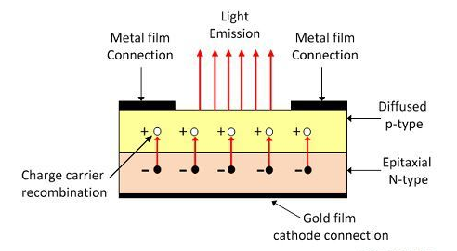
LED Monitors
The full form of LED is Light Emitting Diode.
The LED is a PN junction diode which emits light when an electric current flows through it in the forward direction.
The LED is constructed by doping the p-type and n-type material.
When the power is applied across the LED the recombination of P-type and N-type material charges takes places.
The recombination of charges gives energy in the form of heat and light.
.
Notes:
Diode-An electronic device that allows current to flow in one direction only, used chiefly as a rectifier

Slide 22
The semiconductor material is translucent (allow light to pass) and it emits light through their junction.
The semiconductor material used galvanised arsenides, which generates red or yellow light.
Several LED is used for representing the one segment and the decimal points are represented by the single LED
2. LCD Monitors
The LCD is used for displaying the texts and images in the form of dot matrix or segments.
The LCD has liquid crystal filament which is filled between the transparent electrodes.
When the current passes between the electrodes, the filaments become energized and emits visible light.
The construction of liquid crystal display is shown in the next slide.
Notes:
Electrodes-The terminal through which electronic current passes between metallic and nonmetallic parts of the electric circuits
Filament- a thin thread or wire

Slide 23
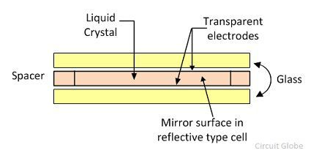
The liquid crystal used in the display has the property of both the solid and the liquid.
When the potential is not applied across the liquid crystal, it becomes transparent but after activation, the crystal scatters light in all directions and appears to be bright.
The LCD consumes less power and also have seven segment displays but it is a slow device and requires more times for switching.
The dc reduces their lifespan and hence mostly they are used with AC having a frequency less than 500 Hz.
Notes:
Crystal-A solid composed of an array of atoms or molecules possessing long-range order and arranged in a pattern which is periodic in three dimensions

Slide 24
Key Difference between LCD and LED Monitors
LED Monitor | LCD Monitor
The LED is a PN junction diode which emits visible light when the forward bias(voltage or current) applies across it | The LCD uses liquid filaments which are filled between glass electrodes for the emission of light.
LED uses the PN-junction diodes for displaying the light. The backlight refers to the turning on and off of the displays for better vision | The LCD uses cold cathode fluorescent lamp which provides the backlight of the screen
The resolution of the LED is much better than that of LCD. The resolution is the number of pixels on the display of the screen | The resolution of the LCD is much lesser than that of LED
Notes:
Diodes- an electric device that allows current to flow in one direction only, used chiefly as a rectifier
Rectifier is a device that converts the alternating current into direct current, often a diode.

Slide 25
Continued -------
The LED consumes more power as compared to LCD because of the plasma. | The filament used in LCD is made up of plasma, which requires less power for activation.
The display area of the LED is less as compared to the LCD because LED use PN-junction diode which displays light only in the one direction | The display area of LCD is high because LCD display lights in all the directions.
The LED uses gallium arsenides which when heated emits light | The LCD uses liquid crystals which are energized and provides light.
The switching time of the LED is less as compared to LCD. The switching time is the active and deactivated time of their display. | The switching time of the LCD is high as compared to LED.
Notes:
Plasma: A visual effect in which cycles of changing colors are warped in various ways to give the illusion of liquid organic movement
Gallium: A chemical element with an atomic number of 31, a soft bluish metal.

Slide 26
Continued----------
The direct current in LED has no effect on its lifespan. | The direct current reduces the lifespan of LCD
The contrast ratio of the LED is less as compared to the LCD. The contrast ratio is the ratio of the luminance of the visible and darker light of the screen. | The contrast ratio of the LCD is high as compared to the LED.
The LED does not use mercury. | The LCD uses mercury which pollutes the environments
Note: The LED and LCD both are the modern technologies. But LED has more advantages than LCD and hence it is mostly used for making the displays.

Slide 27
Factors that determines the Quality of the Monitor
Size
The size of a monitor is measured diagonally across the screen, just like TVs.
Common monitor sizes are 15, 17, 19, and 21 inches.
The most popular monitor size is currently 17 inches.
b) Resolution
Every image on the screen is composed of tiny dots(single points).
These points are called pixels(short for picture elements).
So, the screen is divided in to thousands(millions) of pixels which are arranged in rows and columns.
Resolution refers to the number of pixels that can be displayed on the monitor screen.

Slide 28
Resolution is always be written as:
Number of pixels horizontally x Number of pixels vertically
Example: Resolution=600 x 800:
Meaning there are 600 pixels horizontally and 800 pixels vertically and a total of 480,000 pixels.
As the resolution increases, the quality of the display increases and the image will be sharper and we can see more details of pictures.
c) Dot Pitch:
Dot pitch refers to the distance between each pixel, or dot, on the screen, as measured in millimeters (mm).
The smaller the dot pitch, the closer the dots, and the sharper the image is.
If you’re in the market for a monitor try to find one with a 0.28 mm or less.

Slide 29
d) Refresh Rate:
The refresh rate of your display refers to how many times per second the display is able to draw a new image.
This is measured in Hertz (Hz).
For example, if your display has a refresh rate of 144Hz, it is refreshing the image 144 times per second.
In order to take advantage of higher refresh rates, three of the most important components to consider are:
A monitor with the ability to refresh quickly.
A CPU that’s fast enough to provide critical game instructions, including AI, physics, game logic, and rendering data.
A GPU (Graphics Processing Unit) that’s fast enough to execute these instructions quickly and create the graphics you see on the screen.

Slide 30
e) Color Depth(Bit Depth)
Color depth is the number of colors that are displayed on the screen at once.
It is determined by the number of bits used to represent a pixel.
As the number of bits used to represent a pixel is increased, then the number of colors that a pixel can display will increase.
For example, if 8 bits are used to represent a pixel, then 2⁸=256 colors can be displayed by each pixel.
Example Monochrome monitor: one bit is used for one pixel.
Therefore, they have only two types of colors(2¹=2).
Most modern monitors use 24 bits to represent a pixel.
This implies 2²⁴ possible colors can be displayed using one pixel.

Slide 31
3. System Unit
A System unit also known as a Base unit is the main body of a desktop computer.
Inside of the system unit, there are a number of components. Some of them are:-
Memory
CPU
Motherboard
Power Supply
Cooling Fans
Internal Disk Drivers
Expansion cards and Slots.

Slide 32
Power supply:-
The Pc power supply converts 120/240 volts alternating current (AC) into 5/12 volts Direct current(DC) used by the PC.
The PC power supplies have built-in power on/off switches and power connects for the motherboard and the disk drives.
B. Motherboard
It is the Main circuit board in system unit
It Contains adapter cards, processor chips, and memory chips
Another name of mother board is called system board
Every components of a computer inside the system unit is directly or indirectly connected to the motherboard.
The following figure shows a motherboard that contains a number of components.

Slide 33
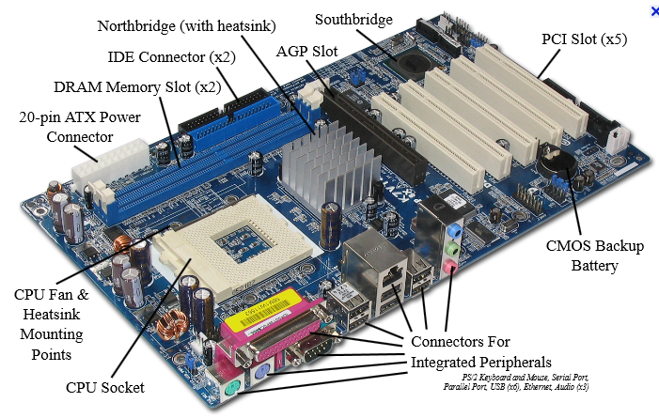

Slide 34
C. Ports
Port is used to connect external devices to the motherboard.
It is classified as Serial port and parallel port.
Serial port
It is a Transmits one bit of data at a time. It connects slow-speed devices, such as mouse, keyboard, and modem.
Parallel port
It is connects devices that can transfer more than one bit at a time, such as a printer and Disk Drivers.
Special-purpose port:
Allow users to attach specialized peripherals (digital video cameras, color printers, scanners, and disk drives) or transmit data to wireless devices.
For example: - FireWire port, MIDI (Musical Instrument Digital Interface) port, SCSI (small computer system interface) port, IrDA (Infrared Data Association) port, and Bluetooth TM port.

Slide 35
D. Expansion slot and Card
Adapter card: - is used to enhance system unit or provides connections to external devices called peripherals. Adapter card is called an expansion card.
An expansion slot: - is an opening, or socket on the mother board that can hold an adapter card with Plug and Play.
The computer automatically configures cards and other devices as you install them.
E. Central Processing Unit
To process, the computer needs two components, the central processing unit & memory.
The processor (CPU) is the one that actually process & memory is needed to store the data & instructions currently used by the CPU.
The CPU (Central Processing Unit) or processor is a microprocessor chip (a silicon chip with complex circuits) found on the motherboard.

Slide 36
All computer operations are under the control of the CPU, which has the following functions: -
It controls the transmission of data from input devices to memory
It processes the data held in main memory or execute instruction
It controls the transmission of information from main memory to output devices etc.
The CPU has got three main components:
Control Unit
Arithmetic Logic Unit (ALU)
Register
1. Control Unit (CU)
It controls the flow of data & instructions between the CPU & Memory, between the CPU & Input/ Output devices, etc.
It is responsible for loading, interpreting the individual instructions that comprise the computer program.

Slide 37
The control unit also has the task of getting the data needed by the instructions and returning the result of the processing after the instruction has been executed.
To summarize tasks carried out by a CU are listed below:
Decoding the instructions within a computer
Sequencing the reading and writing of data within the CPU and externally on the data bus
Controlling the sequence in which instructions are executed
Controlling the operations performed by the ALU
Control unit does not execute instruction or it does not carry out instruction processing by itself rather it directs other processing elements to execute instructions.
As human brain controls the body, control unit controls the computer hardware
In general it serves as the computer traffic cope of the computer.

Slide 38
2. Arithmetic Logic Unit (ALU)
ALU performs arithmetic and logical operations of the microprocessor.
Arithmetic operations includes like addition, subtraction , multiplication and division.
Logical operation is concerned with the comparison of data.
It includes operators like less than, greater than, equal to, less or equal to, greater or equal to, different from, etc.
Eg. If marks >80, grade is “A”
ALU also performs AND, OR, NOT and EXCLUSIVE-OR logical operation.
From where ALU gets data to perform its required operations:
Get Data from Registers of the microprocessor,
Processes the data according to the instructions from the control unit and
Stores the results in its output registers or memory.

Slide 39
3 Registers
Fast memory locations within the CPU that are used to create and store the results of CPU operations and other calculations.
In the Computer Architecture, registers are special types of computer memory which are performed their tasks quickly such as (Fetching, transferring, and storing) data and instructions.
Register memory is smaller compare to other computer memory like as Main Memory, Secondary Memory, and Cache Memory.
All computers required these registers to manipulate data, and store memory addresses.
Main objective of using memory addresses is to identify the next instructions that to be executed, after completing execution of the currently instruction.

Slide 40
Types of Registers
Memory Address Register
Program Counter Register
Memory Data Register
Accumulator Register
Index Register
Memory Buffer Register
Data Register
Address Register
Instruction Register
Instruction Pointer Register
Stack Control Register
Flag Register
General Purpose Registers
Special Purpose Register

Slide 41
A. Memory Address Register (MAR)
The main objective of this register is to store all memory addresses of entire data and instructions.
MAR helps to make the communication with using of MDR (Memory Data Register) in between the CPU and Main Memory.
For example – If, CPU (Center Processing Unit) needs to hold few data in to Primary Memory otherwise to fetch some data from memory side, then it places those addresses which are needed into main memory in the MAR (Memory Address Register).
B. Program Counter (PC)
It is also known as Instruction Pointer (IP) in the Microprocessors, but sometimes few people is known as named with “Instruction Address Register”.

Slide 42
Program Counter register’s function is to hold all records in sequence of entire execution of programs.
PC has the memory address of further instruction that is fetched in next step (stores the next instruction to be executed by the CPU).
PC registers to keep track the address of next instruction which to be fetched from the primary memory, if recently instruction is completely executed.
It helps to count all numbers of entire instructions.
C. Memory Data Register (MDR)
This register is needed after completing the execution in PC register.
CPU fetches some mandatory instructions and data from main memory side then its temporary copy is saved into this data register before decoding this data.
So, MDR register works as a middle buffer

Slide 43
D. AC Register
AC register is also called of the “Accumulator Register“, because this register holds the integer values which are needed by the ALU (Arithmetically Logical Unit) while executing of any specific instruction.
The main function of Accumulator Register is to store the output which is generated by your system.
When CPU (Center Processing Unit) will execute some instruction then it will produce the result, now AC register is needed to store those produced data.
E. Index Register
Index register helps to update operand while running of the programs in the computer’s CPU.

Slide 44
F. Memory Buffer Register (MBR)
This register contains the information of data or instruction which are read or written in the main memory.
So, Memory Buffer Register’ function is to hold all data and instruction that are fetching or going to the primary memory side.
G. Data Register
Mostly, these types of register are embedded into microcomputers for temporary storing data being transmitted or from other peripheral devices.
H. Address Register(AR)
The main function of this register is to hold the memory location of instruction which is being executed.

Slide 45
I. Instruction Register (IR)
This register is used to store those data which are needed in currently execution period.
J. Instruction Pointer Register (IPR)
The main function of this register is to hold memory location that is executed in the next level.
So, IP register stores the sequence of all instructions that are to be performed.
K. Stack Control Register(SCR)
It is pre set memory location in which data is saved and retrieved in the specific order LIFO (Last-In-First-Out).
The main function of SCR Register is to handle the stack in the Computer System.
To manage stack functionality, to use two special registers (SP and BP).
Notes:
BP (Base Pointer) is used for preserving space to use local variables.
SP (Stack Pointer) is used to point the current stack.

Slide 46
L. Flag Register (FR)
This register helps to indicate the specific condition.
Flag register contains the one or two bytes, and further every byte is splitted into 8 bits.
And every bit delivers the flag means condition.
Few flags register are Carry flag, Parity flag, Sign flag, Zero flags, and Overflow flag.
M. General Purpose Register(GPR)
These are unified types of registers.
These registers are capable to store the memory addresses, data values as well as floating-point values.
Mostly, GPR registers are used into modern CPU and GPUs due to their best flexibility.
N. Special Purpose Register (SPR)
This register is used to hold the program state.
SPR registers are enabled with PC (Program Counter) and SR (Status Register).

Slide 47
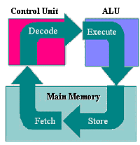
Processing Cycle of CPU
Fetch: The CPU read instruction/data from the memory
Decode: Decoded or interpret the instruction to Computer understandable format.
Execute: The execution of an instruction may require performing some arithmetic or logical operation on data.
Store: The result of an execution may require writing data to memory.

Slide 48
Types of Processors
There are different types of CPUs with different family groups provided by different manufacturers. The following two factors are important to classify CPUs.
i) Compatibility
Every processor has its own set of vocabularies to understand instructions.
So, software written for one CPU may not work with another.
Especially CPUs, which are not in the same family, will differ regarding this.
CPUs in the same family are most of the time backward compatible
Eg: Pentium III is compatible with Pentium II.
Because Pentium III is an improved version of Pentium than Pentium II and it contains all the instructions understood by Pentium II.
ii) Speed
Speed of CPU is one factor that determines the performance of the computer.

Slide 49
But there are also other factors that determines the performance of the computer such as:
Amount of memory or RAM,
Type and speed of the video card,
Hard disk’s speed, free space, and fragmentation
How many programs are running, or multitasking, at the same time.
The speed of CPU is the speed of its internal clock.
It is measured in hertz(Hz).
Hertz is the number of cycles per second.
1Hz= 1 cycle per second
20Hz=20 cycles per second
Large units are KHz (kilo hertz), MHz (mega hertz), GHz (giga hertz), etc
Current CPUs are as fast as 2-3 GHz(2-3 billion cycles per second).

Slide 50
Note:
Actually numbers expressed in Hz to specify speed may not show the exact performance of the system or the computer.
Because the internal architecture of CPUs really has got a role in the performance of computer system.
For example, we can not say with full confidence the 400MHz CPU is faster than the 350 MHz CPU unless and otherwise the architecture of the CPUs are considered.

Slide 51
F. Memory
It is the work area of the computer system. There are two categories of memory: Primary and Secondary.
Secondary Memory:
Consists of the various devices that are able to store data & programs even when the power is off. Example Hard drives, Flash Drives, CD & DVD etc…
Primary Memory:
is the memory that is intimately associated with the actual working of the computers.
This includes memory that holds the start up routines as well as the current program & data it is working with.
Mainly, there are two types of primary memory.
These are: -

Slide 52
1. RAM (Random Access Memory)
RAM is a memory mainly used to store instruction and data currently used by the central processing unit.
As a result, it is called working storage and it is a memory that has a direct relationship with the ALU and CU, which are components of the central processing unit.
RAM is a memory that is logically divided in to many equal sized cells called memory locations.
Each memory location has got a unique address and every memory locations will be accessed using these unique addresses.
Memory is a group of storage locations labeled from zero up to 2^{n}-1.
The label of a location is called its address.
The computer can get the contents of any storage location using these address.
Each cell can store either a 0 or a 1, called a binary digit or bit.

Slide 53
Properties of RAM
RAM is volatile
Any data on RAM will be lost when power is turned OFF or when the current program running is closed.
ii) RAM is read-write memory-
Can read(retrieve) data from RAM and again write(store) to RAM.
In RAM, each memory position can be sensed (read) or changed (written) so it is also called read- write memory
iii) RAM is upgradable memory.
iv) RAM is a memory that can be randomly accessed
You can access any byte without touching the preceding bytes.
That is why it is called RAM because each memory location can be accessed randomly using memory address.
Each unit in RAM has memory address by which it can be easily accessed or referenced

Slide 54
As stated earlier the size of RAM is one factors to determine the performance of the computer.
The size or capacity of RAM is increased through time particularly with the upgrading of the CPU processor speed to make compatible among each other.
The following are the most common capacity or size of the memory:
128 MB
256MB
512MB
1GB
2GB
4GB and
8GB, 16 GB currently

Slide 55
2. ROM (Read Only Memory)
ROM is a memory used to store critical instructions that are used to boot (start) the computer.
Data on ROM is etched when it is fabricated and because of this ROM sometimes is referred as firmware, which means between the hardware and software.
Characteristics of ROM
i. It is non-volatile memory:
Data stored on ROM will not be lost when the power is interrupted
ii. It is a read only memory:
We can read or retrieve data from ROM but we can not ‘write’ (store) data in to ROM.
iii. Data on the ROM can not be deleted or modified, && that is why it contains the boot up instructions.
iv. ROM can also be randomly accessed memory

Slide 56
4. Secondary Storage Devices
The need of secondary storage devices is that to store data permanently.
Factors that determine secondary storage devices:
Access Type:
There are two types of accessing data from secondary storage devices: sequential and random.
Sequential access means to access a particular data; you need to go through the, preceding data before reaching to the required data.
In the case of random access, any random access any data can be accessed randomly without considering the preceding data.
A storage device that has fast access type (direct access type) is preferred.
B. Storage Capacity
It refers to the capacity of the devices to store data.
It is measured in bytes usually with prefixes Kilo byte, Mega Byte, Giga byte etc.

Slide 57
C. Removable:
This one is about whether they are removable (meaning can be carried and moved easily) or not.
There are some secondary storage devices that are needed very much because of this property even if they can store fewer amounts of data and they are slow.
Notice:
Secondary storage devices can be classified based on different criteria.
For example based on their portability, we can classify them as External& Internal and based on the Technology they used Magnetic & optical Storage devices.
Secondary Storage Technologies-three types of storage technologies:
Magnetic storage
Optical storage
Solid State Storage

Slide 58
1. Magnetic Storage Principles:
Electromagnetism is about the relationship between magnets and electricity.
As transistors become on or off to represent 1 and 0 (bits) in memory, bits are represented on magnetic storage devices by magnetizing very tiny iron particles found on the media.
The data storage media of magnetic devices is coated with magnetically sensitive material like Iron oxide.
And these small tiny iron particles will be magnetized by the current passing through the read-write head and aligned in some fashion.
They can wait magnetized and aligned whenever there is no electric power and that is why they are permanent storage devices.
There are lots of devices that use basically this principle to store data even if they are totally different in different aspects to each other. Some of them are Magnetic Tapes and Magnetic Disks.

Slide 59
1. 1 Magnetic Tapes
Magnetic tapes are magnetic storage devices which are the cheaper ones and are slower than the other magnetic storage devices.
They are slow because their data is accessed sequentially and at the same time they are very cheap, with a low cost, you can have high storage capacity.
Thus, magnetic tapes are not common to end-users. But they have advantages:
i. They are used to store data, which is not needed frequently.
ii. They could be used as a back up storage devices.
1.2 Magnetic Disks
Magnetic disks can be accessed randomly and are faster than magnetic tapes.
Hard disk is a set of magnetic disks which are mounted together and covered by a rigid '.

Slide 60
Here the read-write head, the disks and the drive are sealed together. That is why these sometimes called hard drives.
How hard drives work? Hard disk drives consist of:
One or more magnetically sensitive platters,
An actuator arm with a read/write head on it for each platter, and
A motor to spin the platters and move the arms.
An I/O controller and firmware that tells the hardware what to do and communicates with the rest of the system.
Each platter is organized into concentric circles called tracks.
Tracks are divided into logical units called sectors.
Each track and sector number results in a unique address that can be used to organize and locate data.
Data is written to the nearest available area
There is an algorithm that processes the data before it’s written, allowing the firmware to detect and correct errors.

Slide 61
The platters spin at pre-set speeds (4200 rpm to 7200 rpm for consumer computers).
Those speeds correlate to read/write rates.
The higher the pre-set speed, the faster a hard drive will be able to read and write data.
Reading and writing
Each time you ask your computer to retrieve or update data:
The I/O controller tells the actuator arm where that data is located,
And the read/write head gathers the data by reading the presence or absence of a charge in each address.
If the request was to update the data, the read/write head changes the charge on the affected track and sector.
The time it takes for the platter to spin and the actuator arm to find the correct track and sector is known as latency.

Slide 62
Advantages of Hard Disk Drive (HDD)
Low Cost
Low cost or less price than a solid state drive of the same capacity.
2. HDD is High Storage Capacity than a SSD
3. It is highly available in the market for the users who are looking to upgrade their PC or build a new system.
4. The lifespan of HDD is better than SSD because data present on a hard disk drive is directly written on the platter disks which normally does not wear out.
5. Non-Volatile
A hard drive uses magnetic platters disks for storing information's.
These disks have the capability to retrieve the data even when there is no power.

Slide 63
Disadvantages of HDD
Speed
The speed of a hard drive depend upon its Revolutions Per Minute (RPM).
However a traditional hard drive will perform slower compared to a flash memory basically due to its mechanical nature and also the data present in them is fragmented.
These means that computers that have installed hard drives will experience slower boot times and file transfers.
2. Form Factor
Another major disadvantage present in a hard disk drive is its large form factor.
Because of the presence of mechanical parts, a hard drive cannot be manufactured smaller than a certain limit.
This makes them not ideal for portable computing devices such as the laptop, tablets and the smartphones.
Moreover these types of devices always prefer SSD as their storage medium.

Slide 64
3. Power Consumption
For writing data, HDDs constantly relies upon the rotation of platter disks and the movement of read/write head.
These mechanical parts need a power input for them to function.
This is one of the primary reasons why manufacturers consider SSDs if they build a computer with limited battery life
4. Noise
As we all know that hard drives consists of mechanical parts.
Due to the constant rotation of the platter disks and the movement of read/write head there is a distracting noise produced by the hard drive.
This also contributes to vibrations.
Furthermore this noise is more noticeable when the hard drive is in heavy operations like storing large files.
Meanwhile a SSD essentially produces no noise at all.

Slide 65
5. Mechanical Failure
A hard disk drive is more vulnerable to mechanical failures since they contain moving parts.
The platter disks and the read/write head present in a HDD is located in close proximity to each other.
Therefore, whenever there is a drops and shudders they can scrape each other causing damages.
This can result in overall device corruption.

Slide 66
2. Flash Memory Devices
A flash memory device contains trillions of interconnected flash memory cells that store data.
These cells hold millions of transistors that when switched on or off represent 1s and 0s in binary code, allowing a computer to read and write information.
2.1 Flash Drive
One of the most recognizable type of flash memory device that uses solid state technology
It is also known as a thumb drive or a memory stick, these small, portable storage devices have long been a popular choice for extra computer storage.
Before it was quick and easy to share files online, USB-flash drives were essential for easily moving files from one device to another.
However, they can only be used on devices with a USB port.
Most older computers have a USB port, but newer ones may require an adapter.

Slide 67
These days, a USB flash drive can hold up to 2 TB of storage.
They’re more expensive per gigabyte than an external hard drive, but they have prevailed as a simple, convenient solution for storing and transferring smaller files.
Aside from USB drives, flash memory devices also include SD and memory cards, which you’ll recognize as the storage medium used in digital cameras.
2.2 Solid-State Drives (SSD)
SSDs don’t rely on magnets tapes and disks, instead they use a type of flash memory called NAND (NAND is shortly called "NOT AND,“) .
In an SSD, semiconductors store information by changing the electrical current of circuits contained within the drive.
This means that unlike HDDs, SSDs don’t require moving parts to operate.
Because of this, SSDs not only work faster and smoother than HDDs (HDDs take longer to gather information due to the mechanical nature of their platters and heads), they also generally last longer than HDDs (with so many intricate moving parts, HDDs are vulnerable to damage and wear).

Slide 68
Solid state drives use flash memory to deliver superior performance and durability.
Because there are lots of small, moving parts inside your hard drive — magnetic heads, spindles, and spinning platters — it's easy for things to go wrong and you could lose your important data. Without moving parts, SSDs are more durable, run cooler and use less energy.
How NAND works?
SSDs can be thought of as large USB drives; they use the same base technology.
NAND, the technology in solid state drives, is a type of flash memory.
At the lowest level, floating gate transistors record a charge (or lack of a charge) to store data.
The gates are organized in a grid pattern, which is further organized into a block.
Block size can vary, but each row that makes up the grid is called a page.
An SSD controller performs several functions, including keeping track of where data is located.

Slide 69
Reading and writing
Updating data is more complex for SSDs. All the data in a block must be refreshed when any portion of it is updated.
The data on the old block is copied to a different block, the block is erased, and the data is rewritten with the changes to a new block.
Each time you ask your computer to retrieve or update data, the SSD controller looks at the address of the data requested and reads the charge status.
When the drive is idle, a process called garbage collection goes through and makes sure the information in the old block is erased and that the block is free to be written to again.
There is another process called TRIM that informs the SSD that it can skip rewriting certain data when it erases blocks.
Because there are a finite number of times any block can be rewritten, this is an important process that prevents premature wear on the storage drive.

Slide 70
To further prevent wear on the drive, there is an algorithm to make sure that each block in the drive gets an equal amount of read/write processes.
This process is called wear leveling and happens automatically as the drive is working.
Because the read/write process requires data movement, SSDs are usually overprovisioned with storage; there is always a certain amount of the drive that is not reported to the operating system, and not accessible to the user.
This allows room for the drive to move and delete items without affecting the overall storage capacity.

Slide 71
Benefits of SSD | Description
1. Speed | Because of the fact that there is no any mechanical parts in SSDs, it performs fast operations. A normal SSD is about 25-100x faster than a traditional HDD. This paves the way for faster boot times, file transfer, application loading and other basic computing works. Moreover all the read/write functions takes place inside the flash memory chips. Due to this the normal read/write functions are better and faster compared to a HDD.
2. Durability | Non-mechanical nature present in SSD is its durability. As there is no any physical components in SSD, it is not affected by external traumas. Therefore, it is more durable and resistant to drops and shudders. Perhaps even in the event of dropping, SSDs will not face any data losses making it more data secure.

Slide 72
Benefits of SSD | Description
3. Compact | There is a certain limit for the size that can be manufactured in HDD but in SSDs there is no such limitations. Due to the lack of moving parts, a SSD is more compact than a HDD. Because of their compact nature they are most suited for portable electronic devices. Therefore, whenever a portable electronic device such as ultra book and tablets need the use of storage medium then SSDs will be the best option.
4. Less Noise | Due to the constant rotation of the metal platters and the movement of read/write arms, there is a frequent noise produced by the HDD. But unlike in a HDD there is no metal platters and read/write arms in SSDs. Therefore, when the SSDs are in operations it produces no noise at all. The noise value of SSDs have found to be 0 decibels.
5. Power Consumption | Unlike a HDD where it relies upon the magnetic coated platters disks for read/write functioning, there is no any moving parts in involved in SSDs. Because of this it generally consumes less power. Since there is no much power consumed by the SSDs it is considered to be highly energy efficient and less heat dissipation.

Slide 73
Drawbacks of SSD | Description
1. Cost | The primary disadvantage of using a SSD is its cost. The cost of a SSD costs more than twice that of a HDD of similar storage capacity. Eventually the computers with the SSDs as their primary storage medium is going to be more expensive.
2. Storage Space | The storage space offered by a SSD is limited to certain values. The base storage capacity of a SSD is 128GB. SSDs with higher storage capacities are extremely rare to find. Moreover when the storage capacity of a SSD goes up then automatically the device cost keeps increasing as well.
3. Availability | Comparing to a HDD, SSDs are harder to find in the market and expensive piece of devices. But since the advancement of the portable technology, there is a gradual rise of SSD manufacturing, which means that SSDs are becoming more available.

Slide 74
Drawbacks of SSD | Description
4. Lifespan | The flash memories those are used in SSDs are limited to certain number of writes. Because of this the lifecycles present in a SSD is limited. In order for writing data to a SSD, it uses a process known as Write cycles. In this process when a data is written on a SSD the previous blocks present in them will be erased. Whenever this process is completed this eventually lead to cell decaying. Cell decaying basically means that your SSD is slowly facing towards failure.
5. Data Recovery | In the event of a data deletion on a SSD, it is almost impossible to recover the data back. Even though this can be advantageous in terms of data security, this can lead to serious issues if there is no proper backups made. Moreover unlike a HDD, the data present in a SSD is scattered inside the flash memories. Whenever there is any damage to the flash memories there will be no option to recover the data inside it.

Slide 75
3. Optical Disks
In the optical storage devices, all read and write activities are performed by light.
All recording information stores at an optical disk.
Their big advantages are not more costly, light weight, and easy to transport because it is removable device unlike hard drive
Why to Use Optical Storage
In the optical storage devices, all data is saved like as patterns of dots which can be easily read with using of LIGHT. Laser Beam is used like as “Light Source”.
The data is read while bouncing laser beam on the surface of storage medium.
Laser beam creates the all Dots while reading process, but it is used with high power mode to mark the surface of storage medium, and make a dot.
This entire process is also called the “Burning” data onto Disc

Slide 76
3.1 CD-ROM (Compact Disk Read Only Memory)
They have high storage capacity (up to 700 MB). CD-ROM drives will read data, but will not write. The data will be there when they are manufactured. Many application programs are coming stored using a CD-ROM.
3.2 CD-R (CD-Recordable-WORM) {Write Once Read Many)
This is a blank CD and data is going to be recorded by a peripheral device called CD burner or CD writer.
Data could be recorded by CD-R only once which means data could not be erased and replaced by another one.
That is why they are called WARM (Write Once Read Many).
3.3 CD-RW (CD-Rewritable)
These types are erasable or recordable many times. There are also coming high speed optical disks called D VD-ROM with the same size like CD- ROMS but have higher storage capacity.

Slide 77
BASICS OF COMPUTER SOFTWARE

Slide 78
Computer Software
The computer hardware is an electronic device which has the potential of performing the task of solving a problem.
Without its software, a computer is basically a useless lump of metal.
With Software, a computer can store, process, and retrieve information; play music and videos; send e-mail, search the Internet; and engage in many other valuable activities to earn its keep.
Software is a set of programs that instruct the computer to perform a certain action.
Software is a sequence of electronic instructions that tells the computer how to do certain tasks.
A sequence of instructions used to carry out some task is often called a program.
When a computer is using a particular program, it is said to be running or executing the program.
The one who writes those programs is known as a programmer.

Slide 79
Software is written in high-level programming languages that are easier and more efficient for humans to use (closer to natural language) than machine language.
Software has historically been considered an intermediary between electronic hardware and data, which later the hardware processes according to the sequence of instructions defined by the software
Software:- is a collection of programs and routines that support the operations of performing a task using a computer.
Software also includes documentations, rules and operational procedures.
Computer software can be divided roughly into two categories:
System Software:- which manages the operation of the computer itself.
Application Software:-which performs the actual work the user wants.
System software consists of instructions or programs that are used to manage the hardware resources of a computer and perform required information processing tasks.
System software helps to run the computer hardware and computer system.
Notes:
State in computing- is the stable condition of a processor during a particular clock cycle.
In the fetch state, the address of the next instruction is placed on the address bus.

Slide 80
System software primarily exists for the computer itself.
System software consists of instructions or programs that are used to manage the hardware resources of a computer.
It placed between the hardware and the application software, i.e. it is used as an intermediate for the communication between the hardware and the application software of a computer system.
System Software includes:
Driver Software
Server Software
Utility Software
Programming Language Software
Operating System Software
Notes:
0221113748

Slide 81
1. Device Drivers (Sound, Network Interface Card, Modem Card, VGA, Printer, USB driver and etc.) that are used to instruct the devices to perform its required operations.
2. Server Software- are software's that manages a server computer to provide a services to the other computers (client-computer) and other applications.
3. Utilities Software- are software's such as anti-virus that are used to protect computers attacked by malicious programs.
4. System Development(Translating) Software
Are tools to assist a programmer in writing computer programs and software using different programming languages in a more convenient way.

Slide 82
The tools include text editors, compilers, interpreters, linkers, debuggers, and so on.
An Integrated Development Environment (IDE) merges those tools into a software bundle, and a programmer may not need to type multiple commands for compiling, interpreter, debugging, tracing, and etc.
Because the IDE usually has an advanced graphical user interface, to allows the user to use without typing multiple commands
5. Operating System
It is the most important system program used to control all the computer's resources and provide a base upon which the application programs can be written and installed.

Slide 83
Operating System
is a program that acts as an intermediary (interface) between a user of a computer and the computer hardware.
is a program that controls the execution of application programs.
It is a system software that controls and coordinates use of hardware among various applications and users.
It is a program that provides an environment with which other programs can do useful work.
It is a program that performs basic tasks such as:
Recognizing input from the keyboard,
Keeping track of files and directories on the disk,
Sending output to the display screen and controlling peripheral devices.
Allocate and deallocate Memory spaces, scheduling of CPU jobs.

Slide 84
Contd.
The OS must support the following tasks:
Providing the facility to create and modify program and data using an editor.
Access to the compiler for translating the user program from high-level language to machine language.
Providing a loader program to move the compiled program code to the computer’s memory for execution.
Providing routines that handle the details of I/O programming.
Operating system is the first layer of software loaded in to the computer working memory.
It is a program that acts as an interface between the user, the computer software and the hardware resources.

Slide 85
It provides a software platform on top of which other program can run
“The one program running at all times on the computer” is the kernel.
Everything else is either a system program (ships with the operating system) or an application program.
Operating System Functions
Managing Hardware :- OS interacts with hardware using drivers or BIOS.
Providing a user interface: the OS provides a GUI(graphical user interface) so that users will be able to interact with the system easily.
Managing Files: it OS manages and controls the files and folders created.
Running and Managing Applications: The OS installs and runs all other PC software

Slide 86
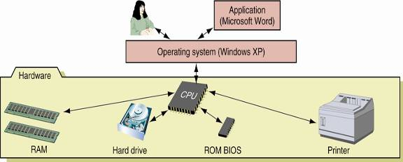
Applications rely on the OS for support operations
Applications are typically tailored to a single OS
Security Management
Coordination of Communication on the network
Figure 1-1 Users and applications depend on the OS to relate to all applications and hardware components

Slide 87
OS Components
All OS have similar core components
Shell
Kernel (core)
The shell exposes functions to users and applications
Piece of software that provides an interface for users using either command-line or graphical interface
Acts as an interface between the user and the kernel.
Shell is normally reside on hard disks and are loaded into memory when needed.
The kernel (nucleus) interacts with hardware devices
Allocates time and memory to programs and
Handles the file store and communication in response to system calls
It resides in memory all the time and is the hub(centeral part) of the OS.

Slide 88
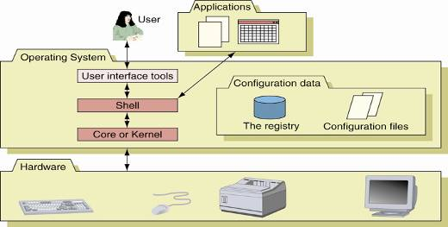
Figure 1-2 Inside an operating system, different components perform various functions

Slide 89
Common tasks performed by OS
Maintain a list of authorized users.
Maintain a list of all resources in the system.
Maintain current status of all users currently using the system (They are called active users of the system).
Maintain current status of all programs being executed by active users and ensure that they receive adequate attention of the CPU.
Maintain current status of all resources in the system and allocate resources to programs when requested.
Handle the requests made by users and their programs.

Slide 90
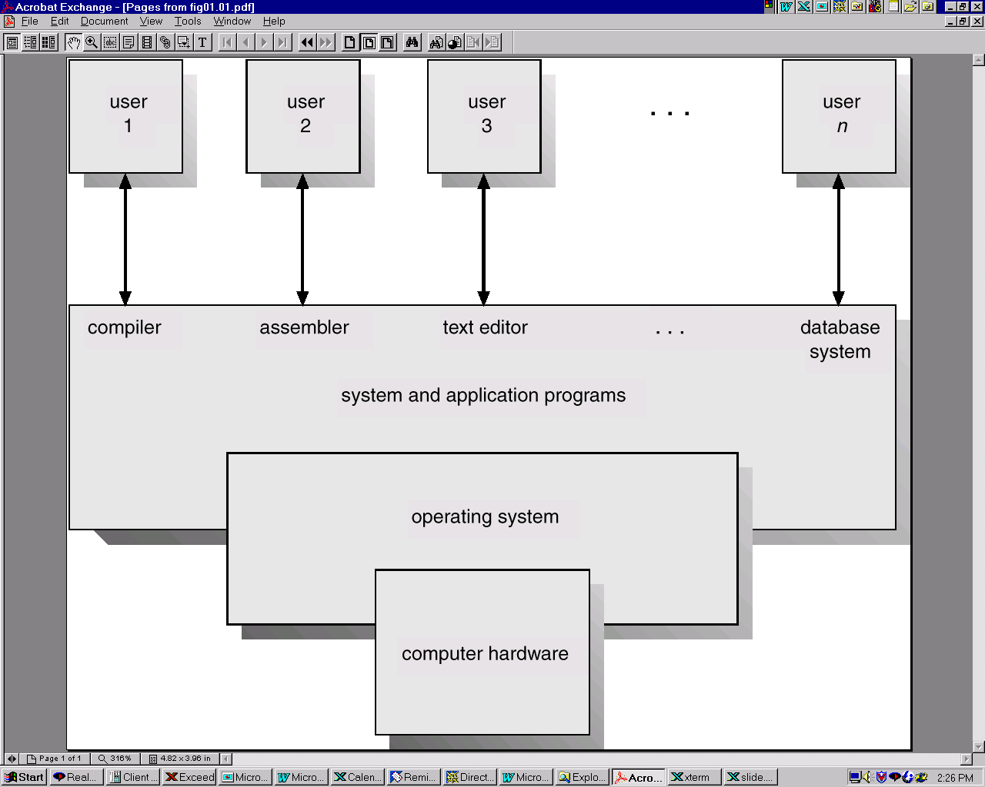
Computer System Components
Hardware:- provides basic computing resources (CPU, memory, I/O devices).
OS:- Controls and coordinates the use of the hardware among the various application programs for the various users.
Applications programs:- define the ways in which the system resources are used to solve the computing problems of the users (compilers, database systems, video games, business programs).
Users (people, machines, other computers).
Figure 1-3 Abstract View of System Components

Slide 91
Examples of where you will find OSs
Servers (Mainframe Computers):- specialized for processing large volumes of requests for a given service.
Generally has a large number of necessary resources.
Web server, file server, print server, time-sharing systems for interactive use, database management systems.
Reduce setup time by batching similar jobs
Automatic job sequencing – automatically transfers control from one job to another
Resident Monitor
Initial Control in monitor
Control transfers to job
When job completes control transfers pack to monitor
Notes:
0

Slide 92
Desktops:- specialized for single-user (or limited number of users).
Generally has a GUI that is integral to system software
Designed to minimize response time to user requests
User convenience and responsiveness.
Can adopt technology developed for larger operating system’ often individuals have sole use of computer and do not need advanced CPU utilization of protection features.
Example:-Windows, MacOS, UNIX, Linux).

Slide 93
Embedded Systems:- Designed or specialized for managing a limited number of resources such as power, memory, I/O speed.
PDAs, cell phones, smart cards, automobiles.
Limited memory
Slow processors
Small display screens.
Clustered (Message-Passing Multicomputer)Systems
are interconnected by a high-speed interconnection fabric.
Each processor has its own local memory and they communicate using the interconnect.
But it:
May share secondary storage.
Loosely coupled.

Slide 94
Clustering can be:
Asymmetric Clustering: one server runs the application while other servers standby.
Symmetric Clustering: all N hosts (or Servers) are running the application.
Real-time Systems:- Specialized systems that must meet stringent performance and behavior requirements.
The goal is to bound worst-case behavior
Medical devices, avionic systems, multi-media players, routers.
Were originally used to control autonomous systems such as satellites, robots and communication systems.

Slide 95
Real-time System is Often used as a control device in a dedicated application such as controlling scientific experiments, medical imaging systems, industrial control systems, and some display systems.
Real-Time systems may be either hard or soft real-time.
Hard real-time:- Secondary storage limited or absent,
Data are stored in short term memory, or read-only memory (ROM)
Conflicts with time-sharing systems, not supported by general-purpose operating systems.
Soft real-time:- Limited utility in industrial control of robotics
Useful in applications (multimedia, virtual reality) requiring advanced operating-system features.

Slide 96
Distributed Systems
Distribute the computation among several physical processors.
Distributed OS runs on and controls the resources of multiple machines.
Distributed OS owns the whole network and makes it look like a virtual uniprocessor or may be virtual multiprocessor.
It is Loosely coupled system – each processor has its own local memory, processors communicate with one another through various communications lines, such as high-speed buses or telephone lines.
Advantages of distributed systems.
Resources Sharing
Computation speed up – load sharing
Reliability and Communications

Slide 97
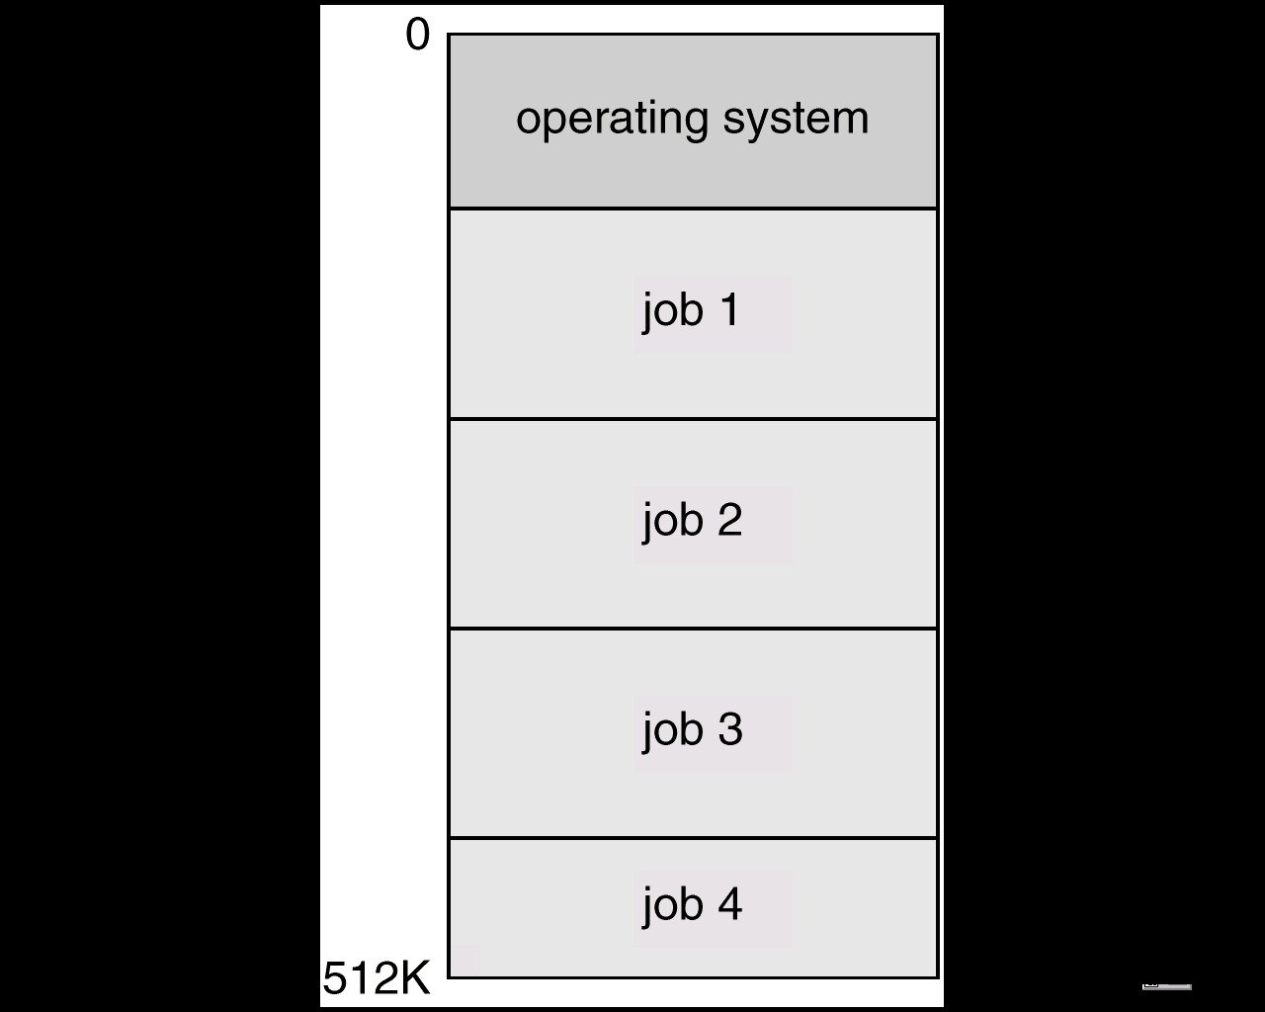
7. Multi-programmed Batch System
Several jobs are kept in main memory at the same time, and the CPU is multiplexed among them.
It assumes a single processor that is being shared
It increases CPU utilization by organizing jobs so that the CPU always has one to execute.

Slide 98
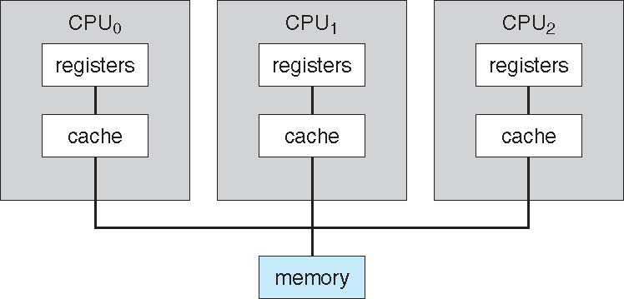
OS Features Needed for Multiprogramming
I/O routine supplied by the system.
Memory management – the system must allocate the memory to several jobs.
CPU scheduling – the system must choose among several jobs ready to run.
Allocation of devices.
Symmetric Multiprocessing Architecture

Slide 99
Operating System Services
Program Execution:- OS loads a program into memory and executes it.
I/O Operations:- since user programs cannot execute I/O operations directly, the operating system must provide some means to perform I/O.
File-System Manipulation:- program needs to read, write, create, and delete files.
The OS gives the permission to the program for operations on file.
Communications- exchange of information between processes executing either on the same computer or on different systems tied together by a network.
Implemented via shared memory or message passing.
5. Error Detection:- ensure correct computing by detecting errors in the CPU and memory hardware, in I/O devices, or in user programs.

Slide 100
2. Application Software
Application software is a type of software that placed between the user and the OS software and allows the user to perform a certain activity- such as creating a document or editing a graphic image.
Typical applications software include office suites, business software, educational software, databases and computer games.
The following are examples of application software.
2. 1. Word Processor
It helps you to create professional looking documents quickly and efficiently.
Using a word processor, you can enter a text, edit it as necessarily, checks for spelling errors, save it and print it.
A Word processing program has the following features:
Word Wrapping, Adding and Deleting, Undo changes, Copy and move

Slide 101
Search and replace
Checking spelling and grammar
Formatting
Creating tables, news-paper style column
Creating graphics within the application or import from other applications.
The following are some of the examples of Word processor program:
Microsoft Word
Lotus Word Pro
WordPerfect
2.2 Spreadsheets
It enables you to enter and edit data, perform calculations, and create graphs from the data.

Slide 102
Data in spreadsheet are organized in to rows and columns.
Each column and row has letters and numbers, respectively, to be addressed by.
The box where a row and a column intersect is called a cell.
Spreadsheet has the following features:
Formulas(e.g. formula=C4*C5)
Functions(e.g. formula=sum(C1:C10)
Automatic recalculation(updates in the parameters of the formula will automatically be made to signify the change in values).
What if analysis
Formatting
Graphs and charts
The following are examples of Spreadsheets program:
Microsoft Excel
Lotus 1-2-3
2.3 Database
It helps you to manage large collection of data in rows.
Database application provide a variety of database objects that are helpful in managing the database.
These include:

Slide 103
Tables to store data
Queries to ask questions and take actions
Forms to add, view and edit data
Reports to print data in a variety of ways
Macros to automate tasks
Modules to automate and customize databases
The following are examples of Database application programs:
Microsoft Access, MY-SQL, SQL, Oracle
Lotus Approach
2.4 Desktop Publishers
A desktop publishing application brings together output from a word processing program, graphics programs and other application to produce a publication, which is easy to read, visually entertaining and informative.
PageMaker and Microsoft publisher are just two examples in the category of desktop publishing application.

Slide 104
Most desktop publishing programs have the following features:
Ability to moving and sizing images
Working with various fonts
Flexibility to change the number and width of columns
Ability to continue a piece of an article any where in the document
Adjusting the spacing between characters and line
Payroll
Sage software
Presentation tools
Microsoft PowerPoint
Lotus Freelance
Desktop publishing
Abode Photoshop
Multimedia applications
Microsoft's Encarta CD-ROM based encyclopedias

Slide 105
There are also a number of Application Software available for specific purposes such as:
Database Application Software- Microsoft Access, SQL, MySQL, Oracle and etc
Web Application Software-
Multimedia Application-
Entertainment and education Multimedia authoring Application Software

Slide 106
Activity
What is a program?
What is hardware?
List the five major components of a computer system.
What part of the computer actually runs programs?
What part of the computer serves as a work area to store a program and its data while the program is running?
What part of the computer holds data for long periods of time, even when there is no power to the computer?
What part of the computer collects data from people and from other devices?
What part of the computer formats and presents data for people or other devices?

Slide 107
9. What fundamental set of programs control the internal operations of the computer’s hardware?
10. What do you call a program that performs a specialized task, such as a virus scanner, a file compression program, or a data backup program?
11. Word processing programs, spreadsheet programs, email programs, web browsers, and game programs belong to what category of software?
12. What is the difference between Windows and Linux operating system? Explain the difference between these two types of operating system and identify the advantages and disadvantages of one over the other.

